Slide 1

Predicting Woman, Infant, and Children Program Participant Churn
University of San Diego
Leonard Littleton and Andrew Zazueta

Slide 2
Table of Contents
Introduction to Problem and Background
Problem Statement
Exploratory Data Analysis
Data Preprocessing
Modeling
Results: Evaluation, Findings, and Interpretation
Conclusion and Next Steps

Slide 3
Introduction to Problem and Background
Woman, Infant, and Children (WIC) was founded in 1974
Provides food assistance to low-income families
WIC issues with participant churn
Families in poverty are twice as likely to stay in the program than those above the poverty level
Why is this issue important for WIC?
WIC benefits from having more participants through grants
The data comes directly from WIC
Participant data is from South Dakota

Slide 4
Problem Statement
Predicting churn helps WIC as well as the families it serves
What is our main objective?
Use machine learning models to predict those who are at risk of leaving the program so that WIC can use the model to lower churn rates.
What is our goal from this objective?
Launching information campaign to those who are predicted to leave the program

Slide 5
Exploratory Data Analysis
Data types found in the data
Binary, non-binary categorical, and continuous data
Non-binary categorical data was later changed to binary
Target feature: certification flag
Engineered from certification start and end date
Turns prediction into binary classification problem

Slide 6
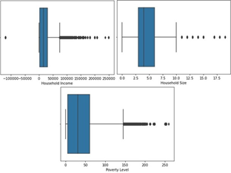
Exploratory Data Analysis (cont.)
Figure 1
Boxplots of Continuous Features in Data Set
Data Quality issues
Outliers in the continuous features

Slide 7
Data Preprocessing
Replacing missing values with mode
Converting multiclass predictors into binary features
Normalizing continuous features

Slide 8
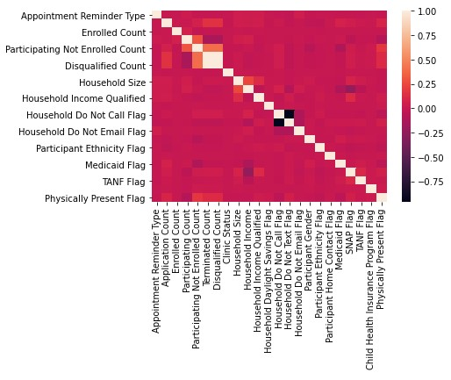
Data Preprocessing (cont.)
Figure 2
Correlation Matrix
Creating new features from existing ones
Engineering target feature dynamically
Removing correlated features
Creating training, validation, and test sets
SMOTE and Random Undersampling used on
training set to account for imbalance data

Slide 9
Modeling - Baseline
Total of 5 models made
Naïve Bayes
Logistic Regression
Neural Net
XGBoost
Random Forest
Naïve Bayes was used for baseline performance as it was the worst performing model
Accuracy – 61%
F1-Score Majority Class – 0.73
F1-Score Minority Class – 0.30

Slide 10
Modeling – Logistic Regression
Easily Interpretable and Simple
Model Performance
Accuracy – 89%
F1-Score Majority Class – 0.93
F1-Score Minority Class – 0.59

Slide 11
Modeling – Neural Net
Ability to Learn Complicated Patterns
Model Performance
Accuracy – 89%
F1-Score Majority Class – 0.94
F1-Score Minority Class – 0.60

Slide 12
Modeling - XGBoost
Used to 20 most important features
Default Parameter Model Performance
Accuracy – 88%
F1-Score Majority Class – 0.93
F1-Score Minority Class – 0.58
Grid search used for hyperparameter tuning
Tuned Model Performance
Accuracy – 89%
F1-Score Majority Class – 0.94
F1-Score Minority Class – 0.60

Slide 13
Modeling – Random Forest
Easily Interpretable
Default Parameter Model Performance
Accuracy – 92%
F1-Score Majority Class – 0.96
F1-Score Minority Class – 0.68
Random search and Grid search used for hyperparameter tuning
Tuned Model Performance
Accuracy – 93%
F1-Score Majority Class – 0.96
F1-Score Minority Class – 0.70

Slide 14
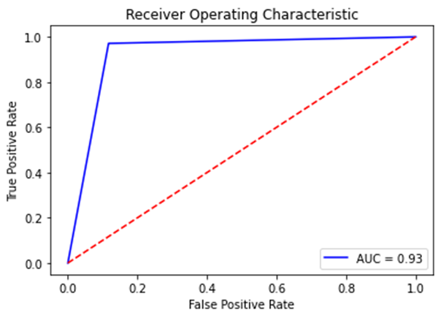

Results - Evaluation

Slide 15
Results - Discussion
End-to-end Data Science project to predict WIC Participant Churn
Data Gathering
Exploratory Data Analysis
Missing Data, Outliers, Data Quality
Feature Engineering
Modeling
Evaluation
Deployment

Slide 16
Results – Notable Findings and Interpretations
Models performed extremely well
93% Accuracy and 0.96 F1-Score on the Majority Class
Information campaign will likely increase WIC Participation

Slide 17
Conclusion and Next Steps
Deploy the model to production
Determine the form of information campaign most appropriate
Analyze participation continuously to track participation increases
Expand to more states outside of South Dakota
Explore more aspects like food insecurity and underserved areas

Slide 18
Thank you!
Thank you to all the professors which taught us everything we need to know to be successful in data related professions!
Emails:
leonardlittleton@sandiego.edu
azazueta@sandiego.edu

